Slide 1

Customer Shopping Behavior Analysis
Uncovering insights from transactional data to guide strategic business decisions.

Slide 2

Project Overview
This project analyzes customer shopping behavior using transactional data from 3,900 purchases across various product categories.
The goal is to uncover insights into spending patterns, customer segments, product preferences, and subscription behavior.

Slide 3

Dataset Summary
Data Volume
3,900 rows and 18 columns of transactional data.
Key Features
Demographics, purchase details, shopping behavior (discounts, reviews, shipping).
Missing Data
37 values in the "Review Rating" column were identified.

Slide 4

Exploratory Data Analysis (Python)
We began with data preparation and cleaning in Python, ensuring data quality for analysis.
Data Loading: Imported dataset using `pandas`.
Initial Exploration: Used `df.info()` and `.describe()` for structure and statistics.
Missing Data Handling: Imputed missing "Review Rating" values using median.
Column Standardization: Renamed columns to snake case for readability.

Slide 5

Feature Engineering & Integration
01
Age Group Creation
Binned customer ages into distinct age groups.
02
Purchase Frequency
Derived `purchase_frequency_days` from purchase data.
03
Data Consistency
Dropped redundant `promo_code_used` column.
04
Database Integration
Loaded cleaned data into PostgreSQL for SQL analysis.

Slide 6

Data Analysis using SQL
Structured analysis in PostgreSQL answered key business questions:
Revenue by Gender: Male customers generated $157,890, females $75,191.
High-Spending Discount Users: Identified 839 customers.
Top 5 Products by Rating: Gloves (3.86), Sandals (3.84), Boots (3.82), Hat (3.80), Skirt (3.78).
Shipping Type Comparison: Express shipping had higher average purchase ($60.48) than Standard ($58.46).

Slide 7
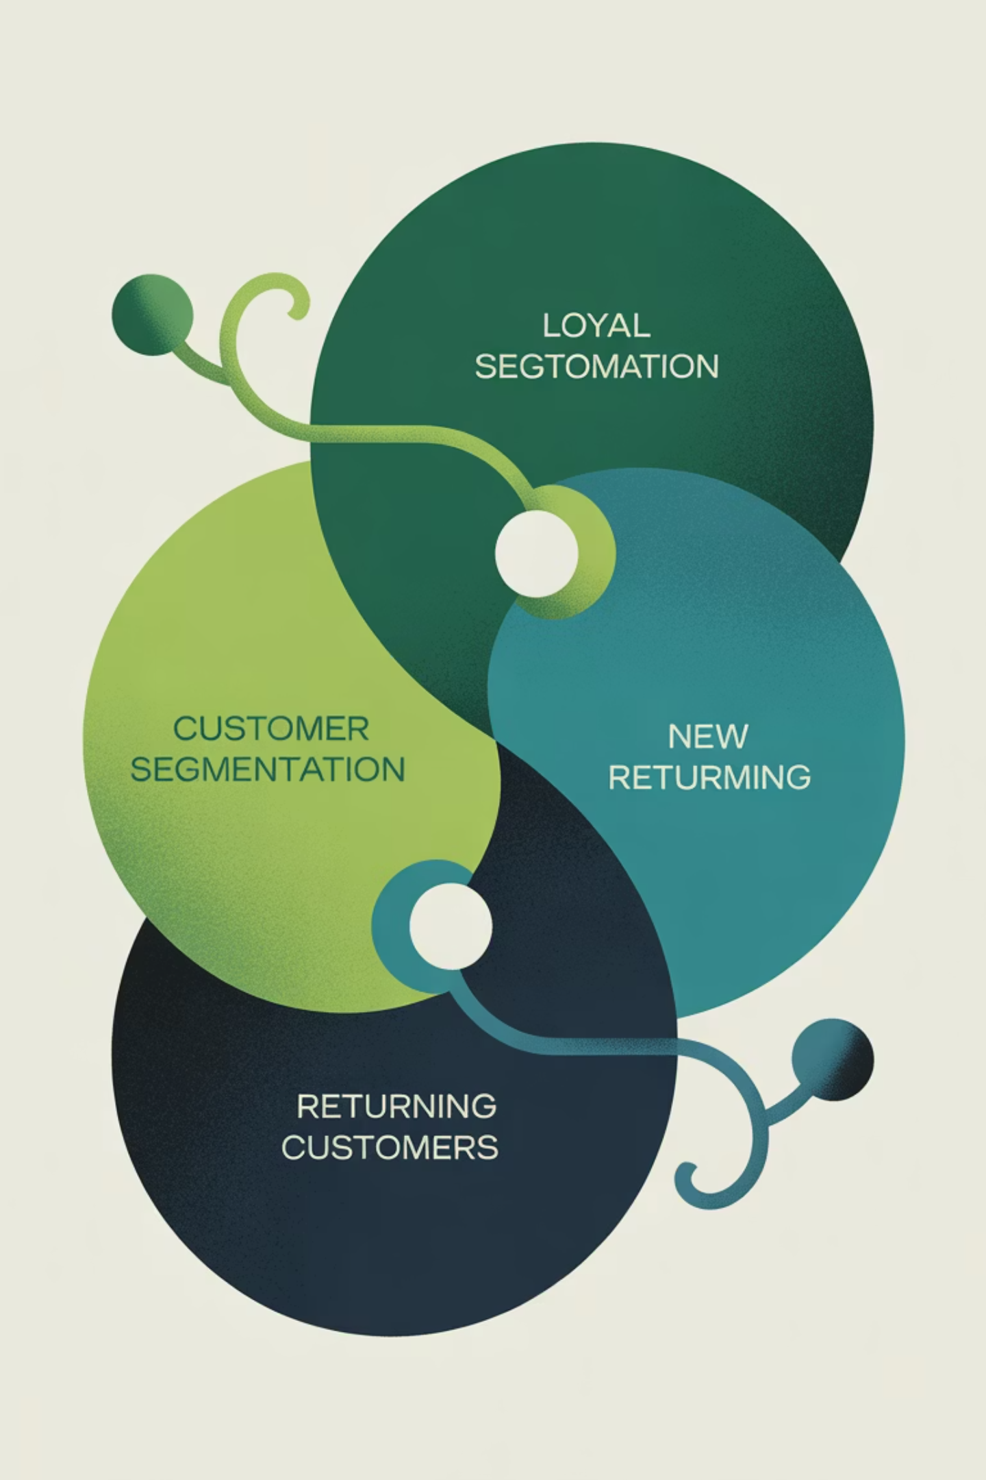

Subscription & Segmentation Insights
Subscribers vs. Non-Subscribers
Discount-Dependent Products
Customer Segmentation
Subscribers: 1053 customers, avg spend $59.49, total revenue $62,645.
Loyal (3116), Returning (701), New (83).
Hat (50%), Sneakers (49.66%), Coat (49.07%), Sweater (48.17%), Pants (47.37%).
Repeat Buyers & Subscriptions
958 repeat buyers are subscribers, 2518 are not.

Slide 8
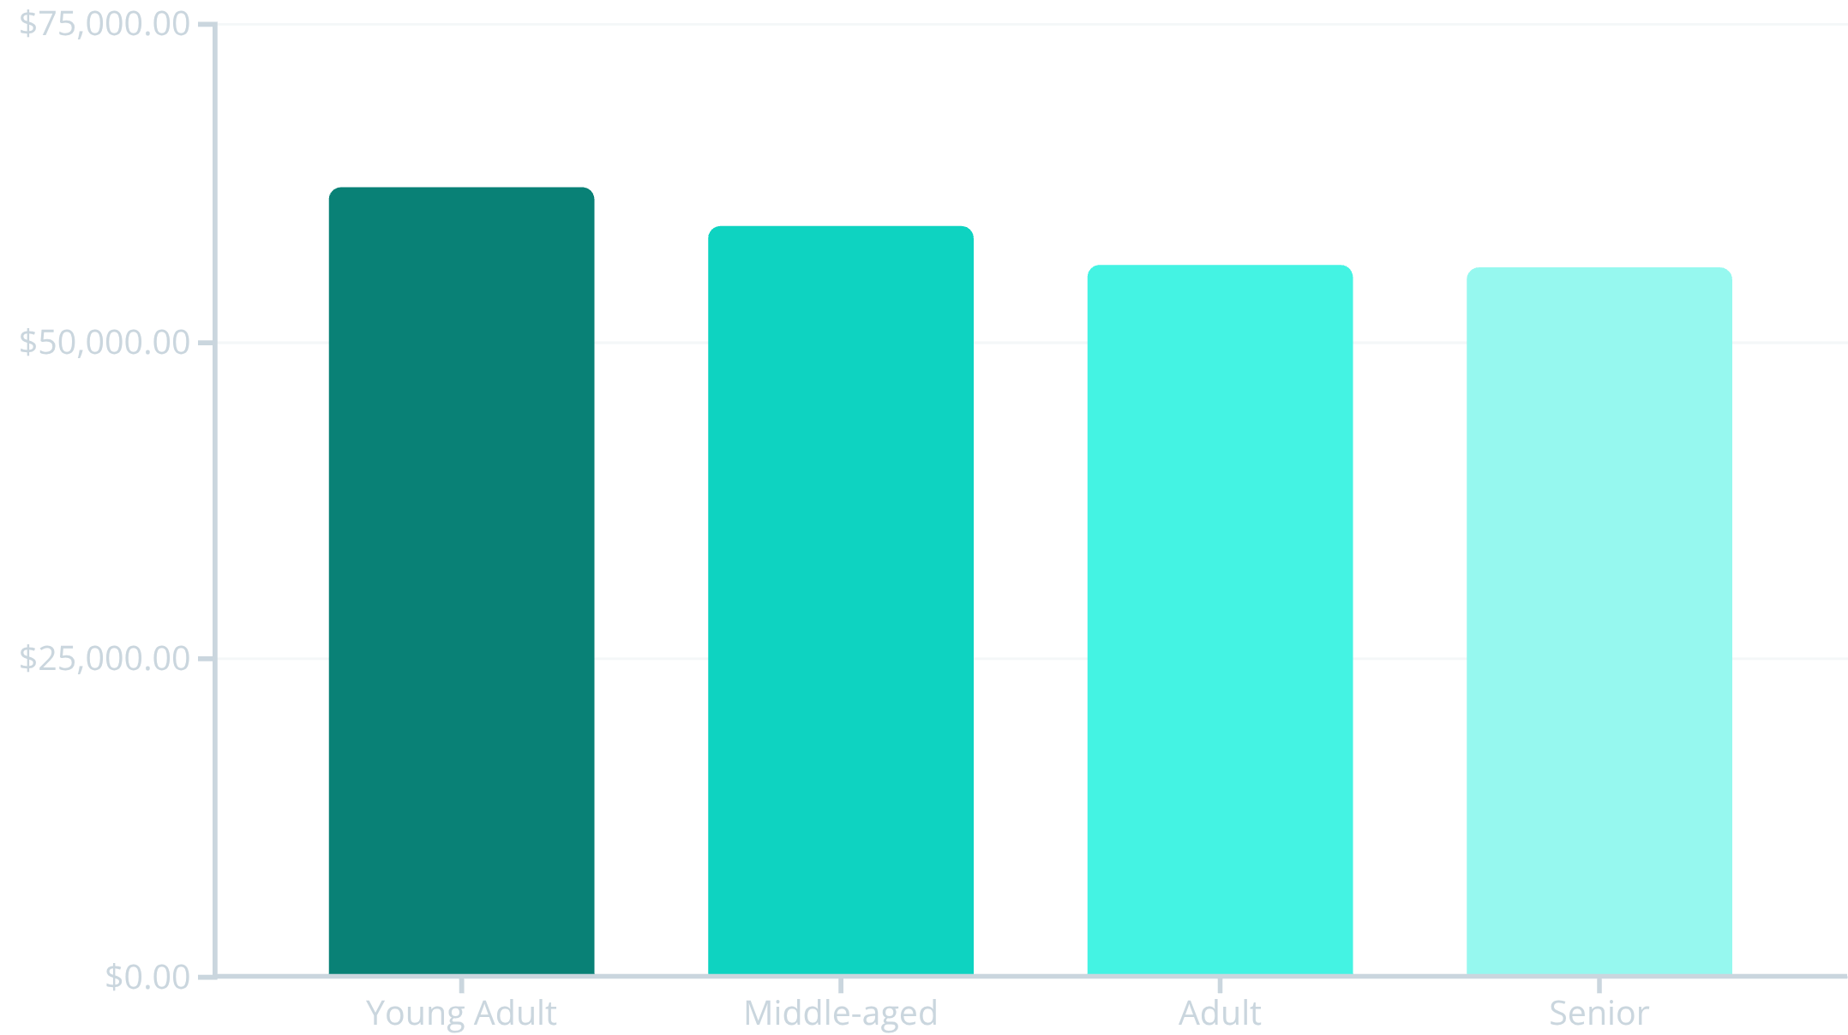
Product & Revenue Breakdown
Top 3 Products per Category
Accessories: Jewelry, Sunglasses, Belt
Clothing: Blouse, Pants, Shirt
Footwear: Sandals, Shoes, Sneakers
Outerwear: Jacket, Coat
Revenue by Age Group

Slide 9
Interactive Power BI Dashboard
3.9K
$59.76
3.75
Customers
Avg. Purchase
Avg. Review

Slide 10
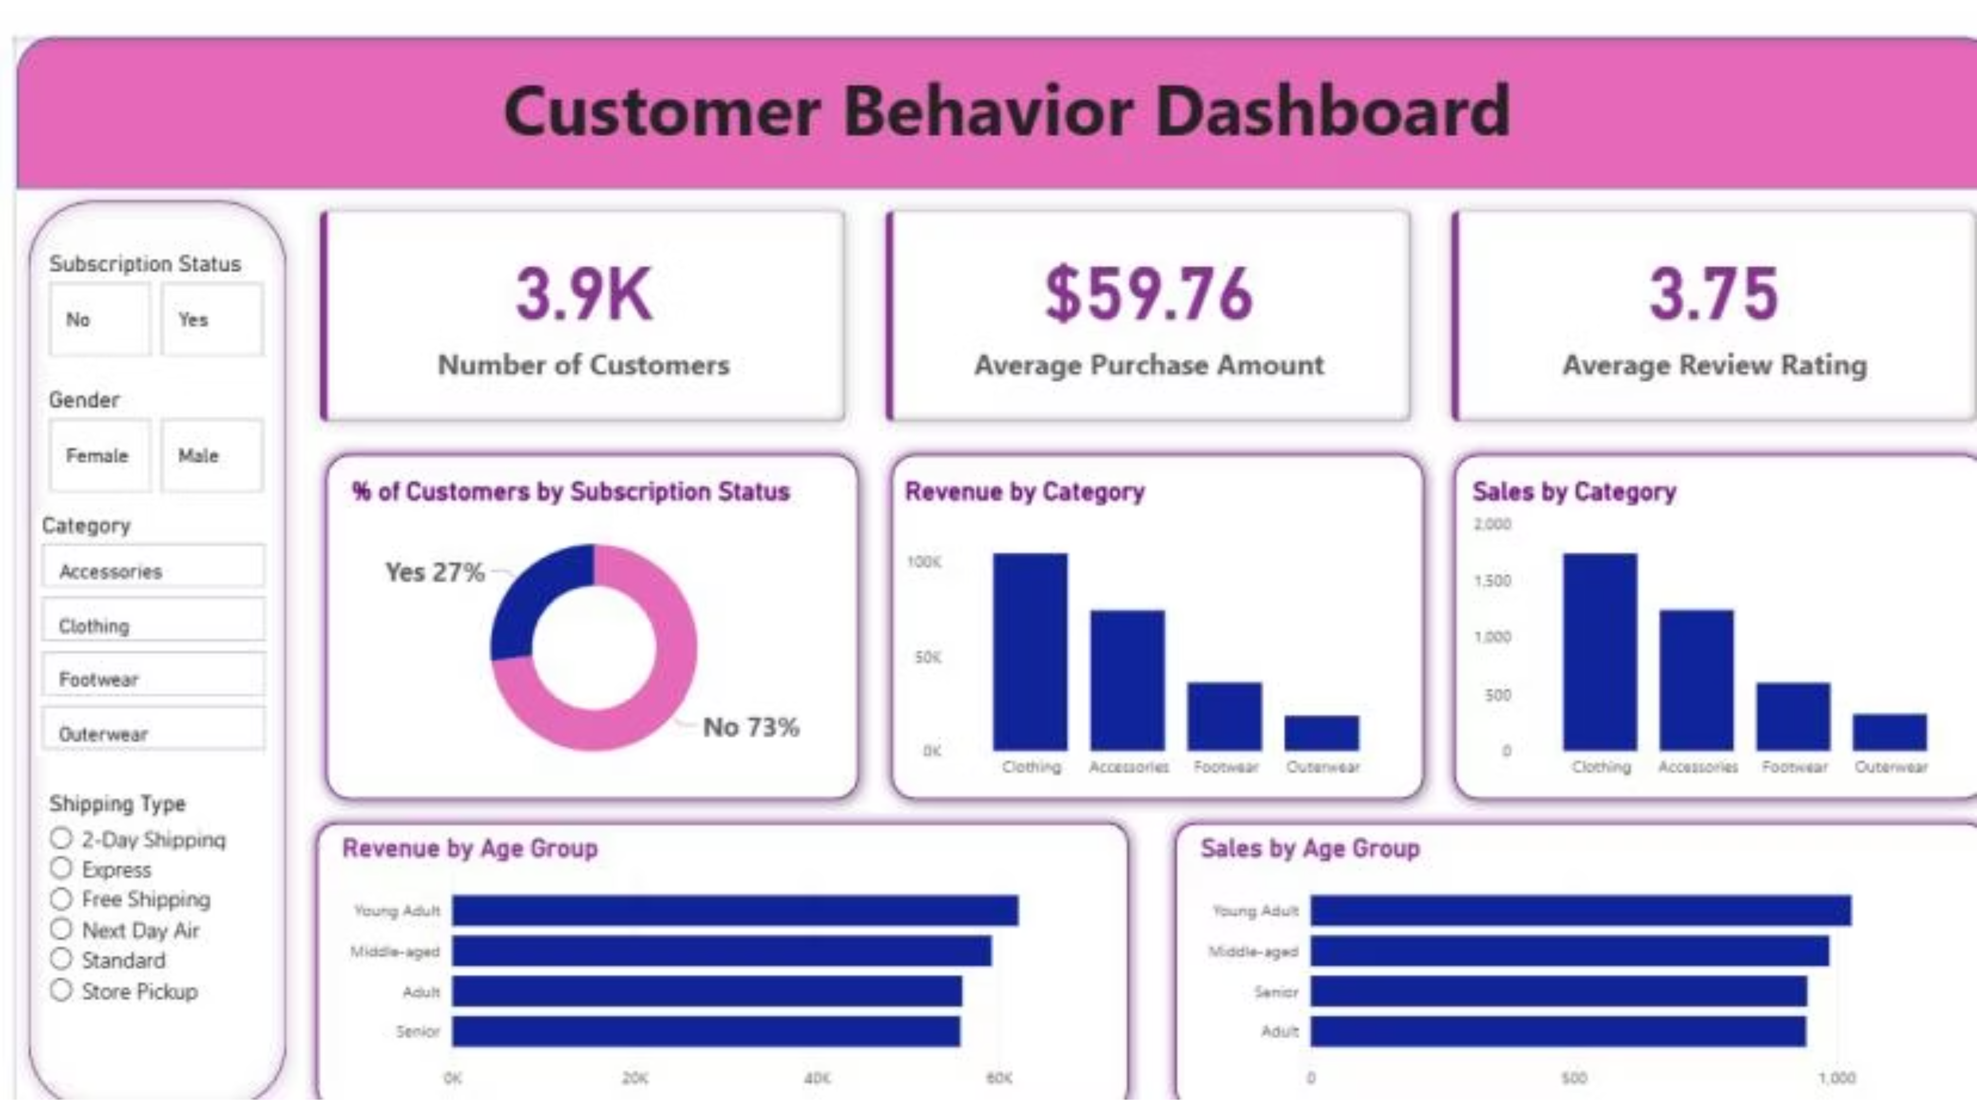

Slide 11
Business Recommendations
Boost Subscriptions
Customer Loyalty
Review Discount Policy
Promote exclusive benefits to increase subscriber base.
Reward repeat buyers to foster loyalty and retention.
Balance sales boosts with margin control for profitability.
Product Positioning
Targeted Marketing
Highlight top-rated and best-selling products in marketing campaigns.
Focus efforts on high-revenue age groups and express-shipping users.

